Slide 1
Cost
Speed
Quality
Value
Perception
Source Diagrams: AXELOS, ITIL Foundation ITIL 4 Edition (2019)
Animations and additional details by Ron Bert

Slide 2
Political factors
Economical factors
Guiding Principles
Opportunity /Demand
Need
Social factors
Environmental factors
Service Value Chain
Value
Practices
Legal factors
Technological factors
Co - Creation

Slide 3
Guiding Principles
Governance
Opportunity /Demand
Service Value Chain
Value
Practices
Continual Improvement

Slide 4
SERVICE VALUE SYSTEM
Guiding Principles
Governance
Opportunity /Demand
Service Value Chain
Value
Practices
Continual Improvement

Slide 5
SERVICE VALUE SYSTEM
Guiding Principles
Governance
Opportunity /Demand
Service Value Chain
Value
Practices
Continual Improvement
Continual Improvement

Slide 6
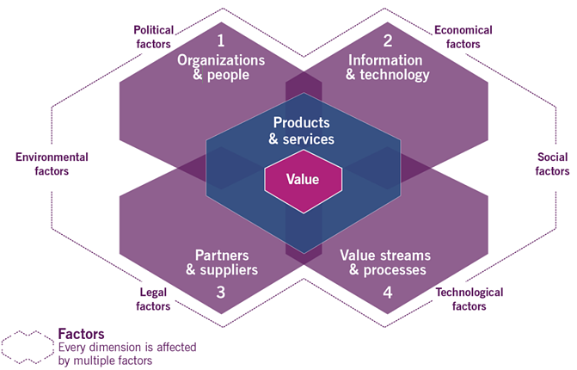
4 Dimensions of Service Management
SERVICE VALUE CHAIN
SERVICE VALUE SYSTEM
1
2
3
4
Organizations
& people
Information
& technology
Design
& transition
1
2
Value Streams
Value
Demand
ACTIVITIES
Value
COGNITIVE
Obtain/build
Value
Deliver & support
3
4
Partners & suppliers
Value streams
& processes

Slide 7
Thank you for watching!
http://www.RonBert.com
Value

